Slide 1
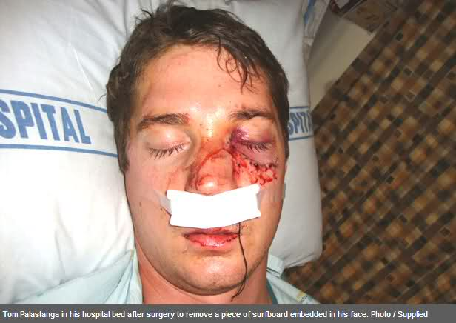
Soft Tissue Injuries

Slide 2
Introduction
Have you ever suffered an injury that bled?
What caused the injury?
How was it cared for?

Slide 3
Introduction
Have you ever suffered a sunburn or another type of burn?
How did the injury happen?
Did it scar?
Could these soft tissue injuries have been prevented?

Slide 4
Soft Tissue Injuries
Students will be able to:
Recognize the signals of bleeding Injuries
Demonstrate proper care for a bleeding victim
Identify signals of burns.
Provide appropriate care for a burn.

Slide 5
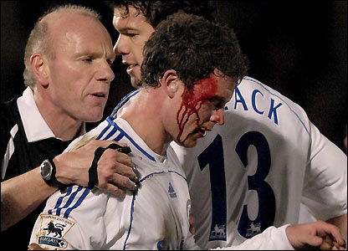
Soft Tissue Injuries
Open Wound
A wound that opens the skin and bleeds externally.

Slide 6
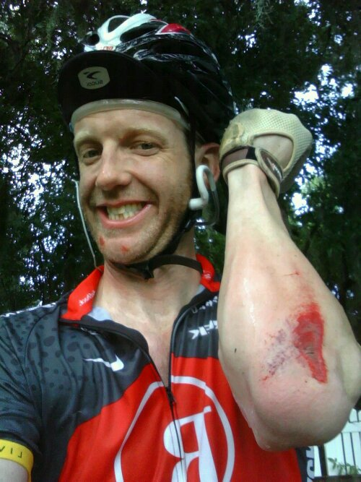
Types of Open Wounds
Abrasion
Also called a Graze
Usually not very deep

Slide 7
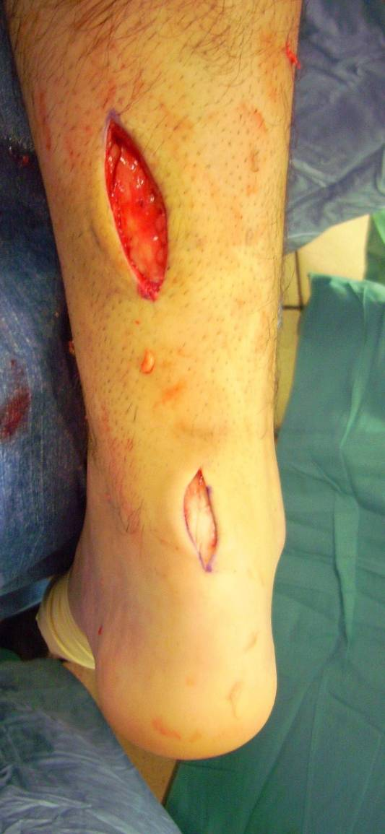
Types of Open Wounds
Incision
A straight line cut
Done by an instrument
Scalpel

Slide 8
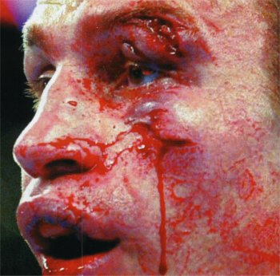
Types of Open Wounds
Laceration
A jagged cut caused by forcible tearing of skin

Slide 9
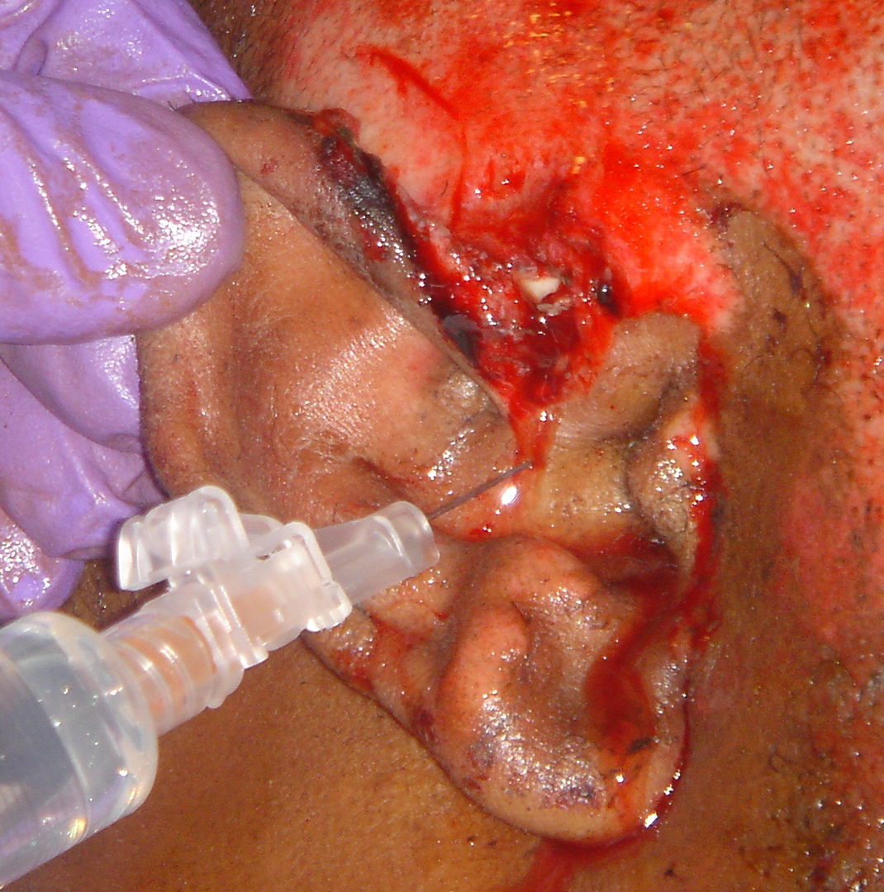
Type of Open Wounds
Avulsion
A tearing away of skin or body part usually leaving a flap of tissue.

Slide 10
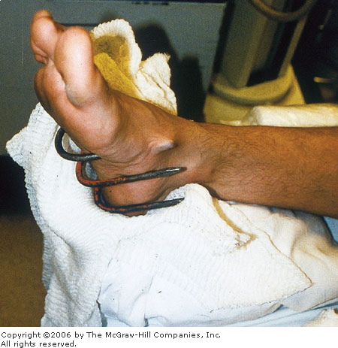
Types of Open Wounds
Puncture Wound
Caused by an object
Penetrates the skin and may still be embedded.

Slide 11
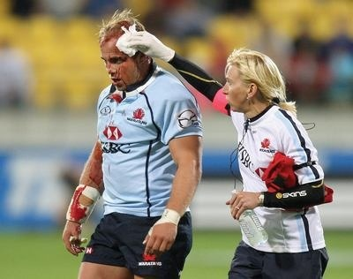
Caring for Open Wound
Direct Pressure
Glove up
Use sterile dressing
Apply pressure for a few minutes

Slide 12
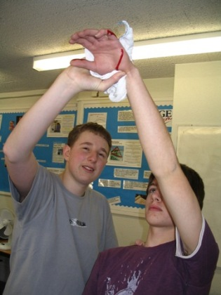
Caring for Open Wounds
Elevation
Maintain direct pressure while elevating injury site above the heart.

Slide 13
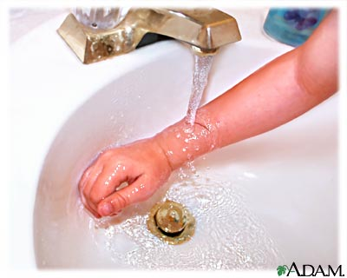
Care of minor wounds
Wash with soap & water
Apply antibiotic ointment
Cover with a Band-Aid or dress & bandage

Slide 14
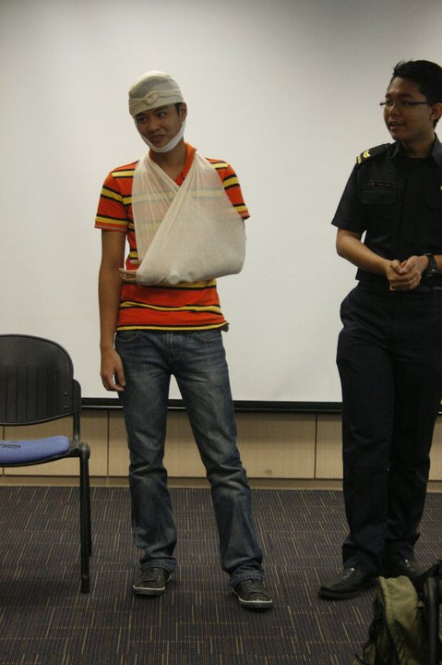
Why Bandage?
Covers body part
Holds a dressing in place
Prevents further contamination
Provides direct pressure to control bleeding

Slide 15
Care for Severe Bleeding
Glove up!
Apply direct pressure
Place dressing on wound
Bandage dressing
If wound bleeds through the dressing & bandage, apply more dressing & bandage on top of existing bandages
Call 911 if bleeding will not stop or is severe

Slide 16
How to Bandage
Secure bandage in place
Bandage should start distal and spiral proximal
Do not cover fingers or toes unless absolutely necessary
Check fingers & toes for circulation
Place sterile dressing on wound
Gauze Pad
Apply roller bandage to anchor in place
Use overlapping spirals & cover dressing completely

Slide 17
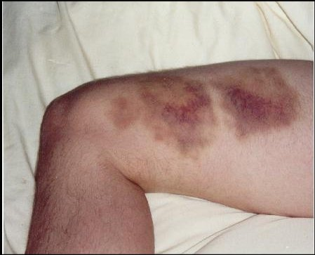
Soft Tissue Injury
Closed Wound
A wound underneath the skin that does not bleed externally

Slide 18
Types of Closed Wounds
Contusion
Bleeding underneath the skin caused by a direct blow
AKA: Bruise

Slide 19
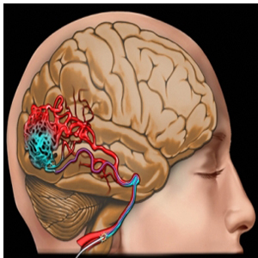
Types of Closed Wounds
Internal Bleeding
Usually associated with vital organs, major blood vessels or deep within the muscle
This can be fatal

Slide 21
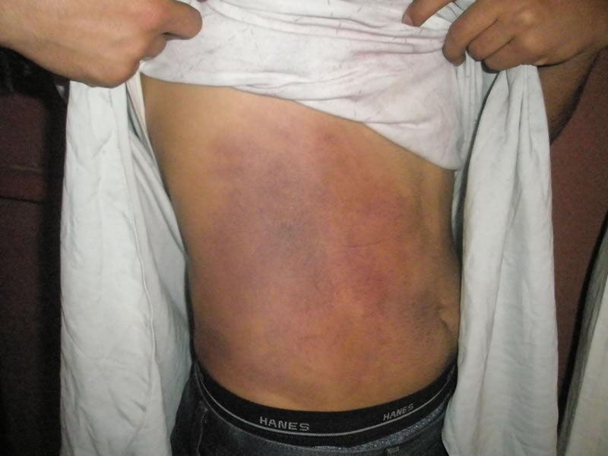
Signs of Internal Bleeding
Because bleeding can not be seen, rescuer needs to identify signs:
Tender, swollen, hard areas of the body
Rapid, weak pulse
Change in skin color (blue or ashy)
Vomiting or passing blood
Excessive thirst
Change in consciousness

Slide 22
Internal Bleeding Care
Call 911/EMS
Have victim rest
Keep victim calm & comfortable
Do not give anything to eat or drink
Keep victim from getting chilled or overheated
If safe to do so, elevate legs about 12”
Monitor ABC’s

Slide 23
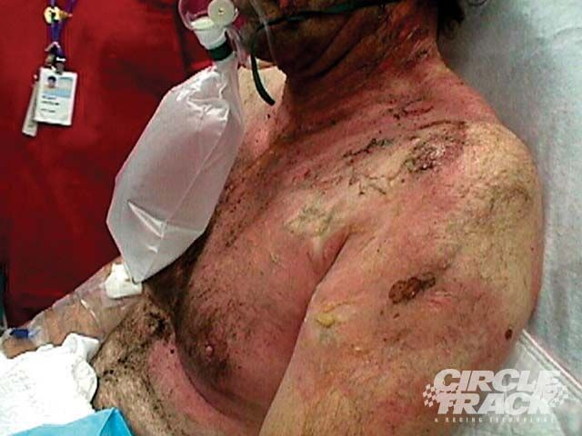
Soft Tissue Injuries
Burns
Injury that results from Heat, Chemical Agents, Electricity or Radiation (sun)

Slide 24
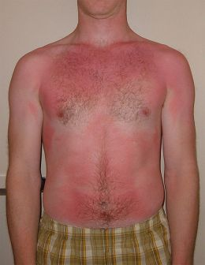
Types of Burns
First Degree Burn
Superficial minor burn that involves skins surface. Tender & slight swelling, will resolve in a week.

Slide 25
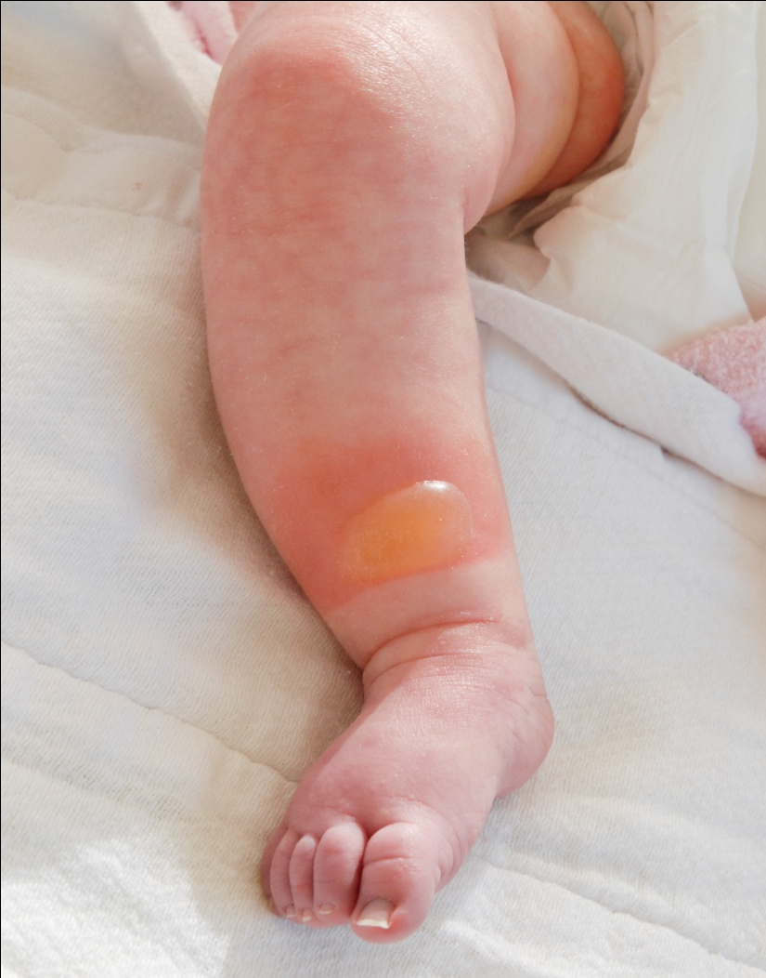
Types of Burns
Second Degree Burn
A burn that exhibits blisters and may scar.
Wound resolves in about 2 weeks.

Slide 26
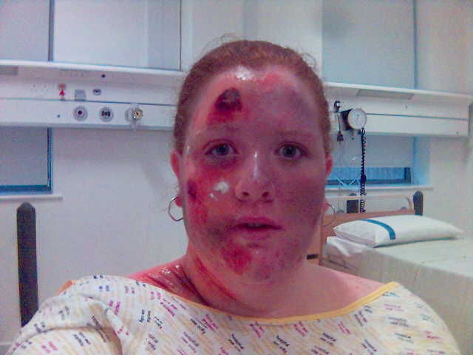
Types of Burns
Third Degree Burn
Severe burn that can damage tissue all the way to the bone.
May be painless due to nerve damage.
Needs medical attention and probably surgery to repair.

Slide 27
Burn Care
Remove victim from burn source
Cool burn with large amounts of water
Cover burn with dry, loose sterile dressing

Slide 28
Soft Tissue Injuries
Burn Care – DON’TS
Burn Care – DOS
Break blisters
Pick out debris stuck in a burn
Try to clean a severe burn
Use any kind of ointment on a severe burn
Touch a burn with anything except a clean covering
Apply direct pressure
Call 911 if:
If caused by chemical, fire or explosion
Airway or breathing difficulty involved
Burns to a small child (5) or elderly person (60)
Burn to head, neck, hands, feet, genitalia

Slide 29
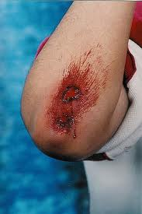
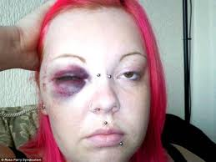
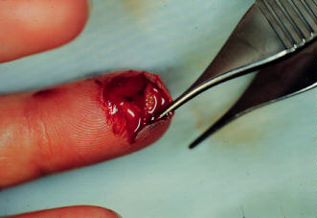
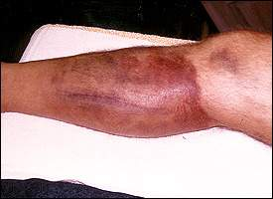
Soft Tissue Injuries

